Slide 1
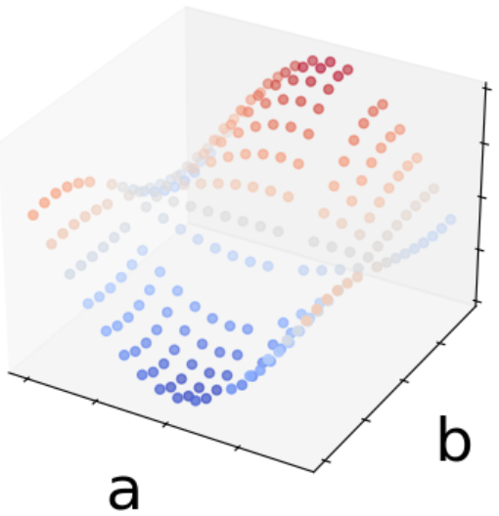
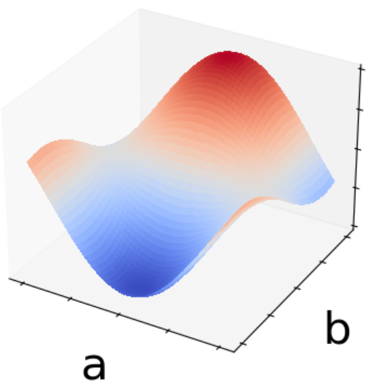

Input
Result
P(a, b)
$$\hat{H}(a, b)$$
Input
01001
01101
11010
Result
P(a, b)

Slide 4

$$\hat{H}(N, a, b)$$

Slide 5
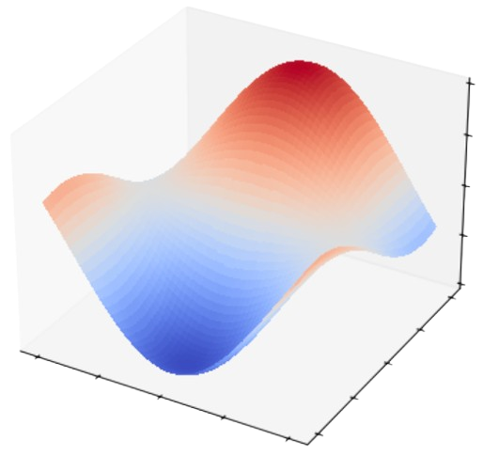
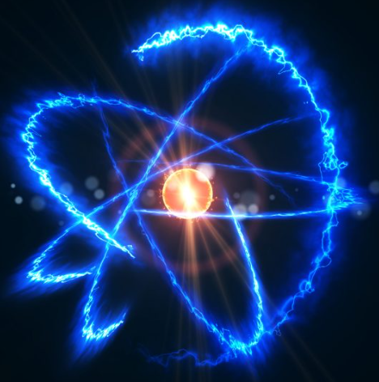
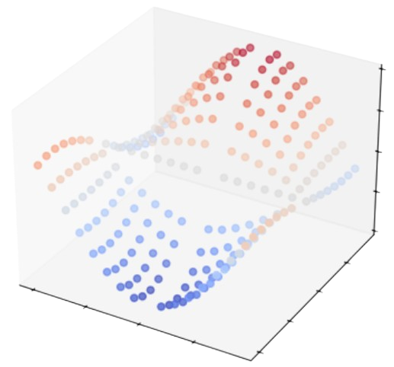
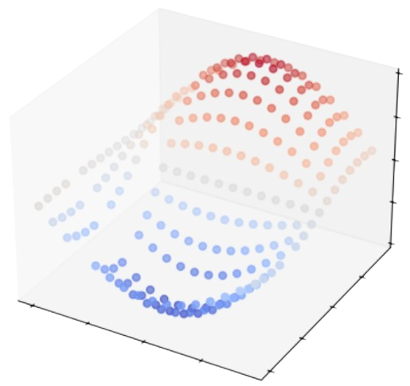
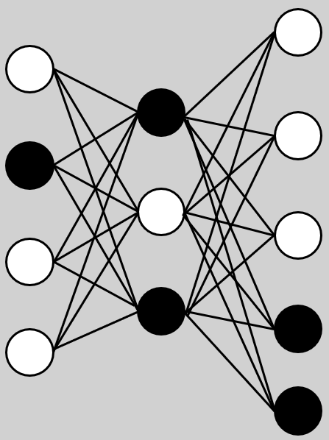
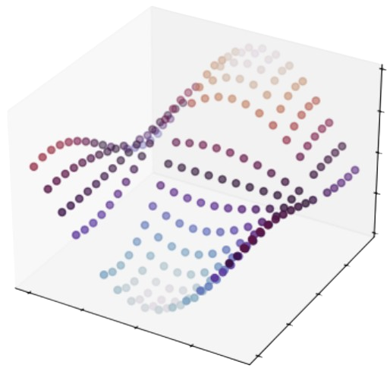





a. Continuous Result
① Quantum System
③ Discrete Results
$$\hat{H}(N, a, b)$$
$$\hat{H}(N, a, b)$$
b. Unseen Parameter Result
$$\hat{H}(N, a, b)$$
⑤ Implicit Repre-sentation
$$\hat{H}(N, a′, b′)$$
② Quantum Simulation
④ Neural Network
c. Larger System Result
$$\hat{H}(N′, a, b)$$
Qubit system

Slide 6
